Slide 1
EECE 315 Design Project - 3-Stage Audio Amplifier
Carson Middaugh
Adrian Moreno Talavera
Professor: Dr. Salehi

Slide 2
Review

Slide 3
Introduction
V_{T} | ꞵ | V_{CC} | A_{V1} | A_{V2} | A_{V3} | V_{E} | I_{C} | V_{BE} | ꞵ/(1+ꞵ) | iR1
25 mV | 100 | 12 V | -15.6 | -16.8 | 1 | 0.4 V | 1 mA | 0.7 V | 1 | 10Ib
The goal of this design project was for students to be able to design, simulate, build, and test a 3-stage audio amplifier using BJT transistors.
We first had to determine several initial variables that were not already given to us, such as Vcc, Ie, and Ve.
Other values like thermal voltage, transconductance (ꞵ), and Vbe were given to us as we determined all our other values.
With all these values in mind, we were able to, within each stage, calculate values for all the resistors, as well as values for Vc and Vb to determine if the transistors would be operating within the Active mode.

Slide 4
Circuit Schematic/Description

Slide 5
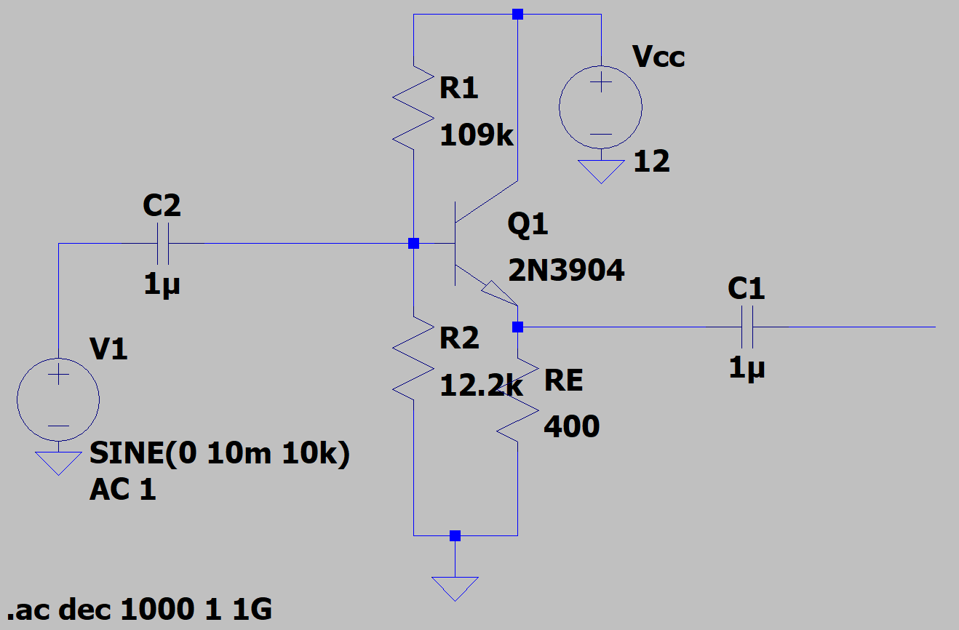
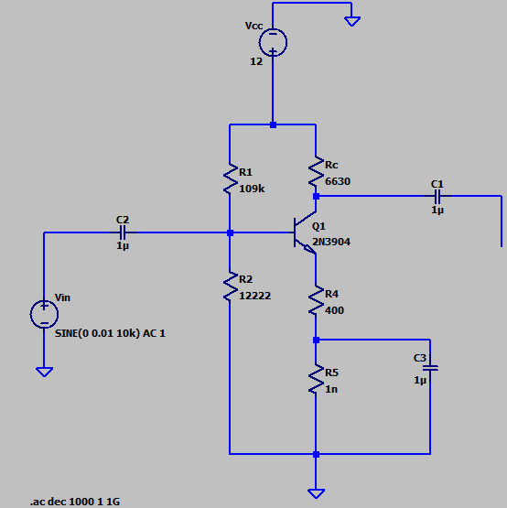
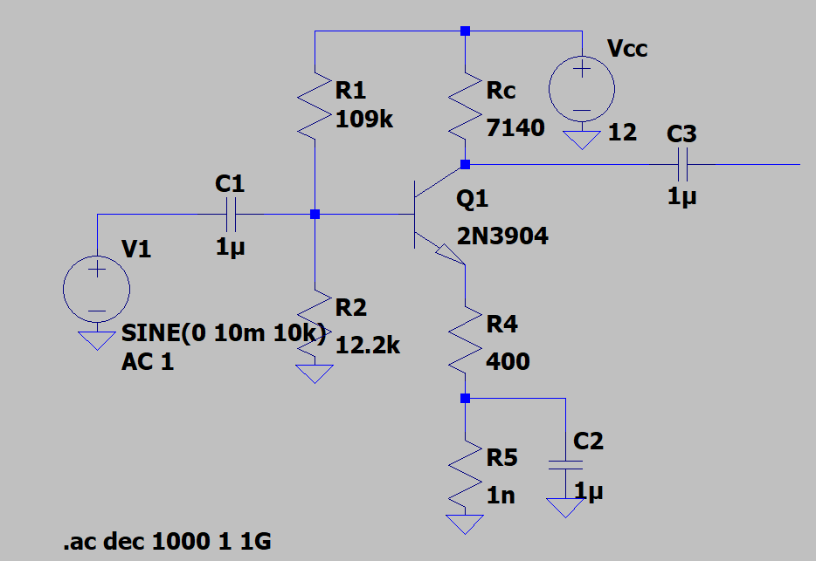
Decoupled Stages of Amplifier
There are three stages to the amplifier:
Stage 1 is a common-emitter amplifier circuit (top)
Stage 2 is also a common-emitter amplifier circuit (center)
Stage 3 is a common-collector circuit used as a buffer stage (bottom)
Each stage has an individual gain:
Av1 = -15.6; Av2 = -16.8; Av3 = 1
These separate gains serve to realize a final gain that would otherwise be impossible using a single transistor.
The third stage, having a gain of 1, serves to change impedance output without any voltage loss

Slide 6
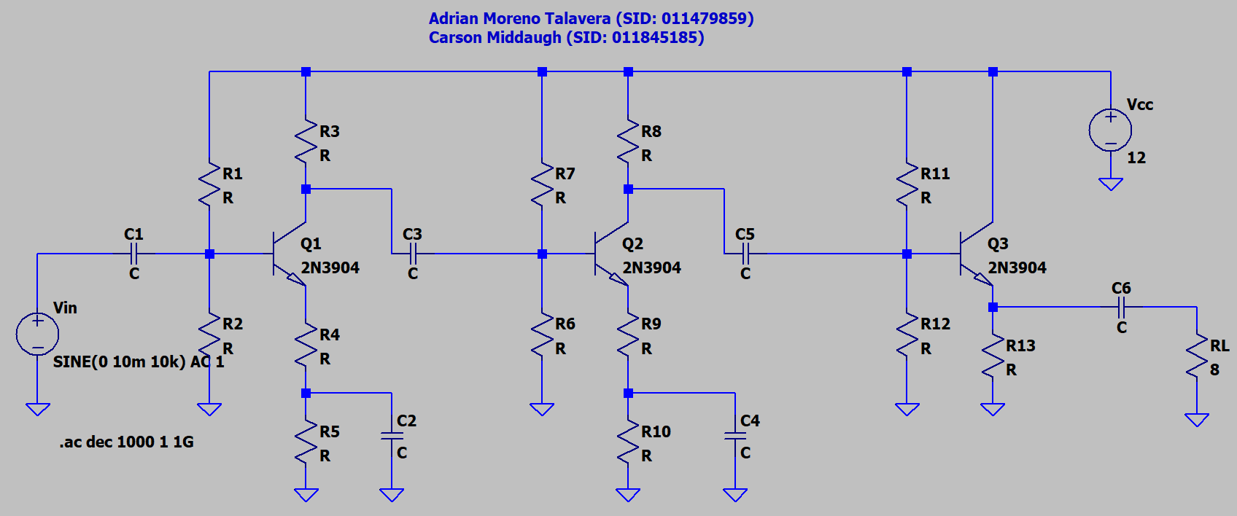
Cascaded Amplifier Circuit
When all three stages of the amplifier are cascaded together, they ideally output a final gain of all the individual gains multiplied. In our case, the ideal final gain would be 15.6 * 16.8 * 1 = 262.08.

Slide 7
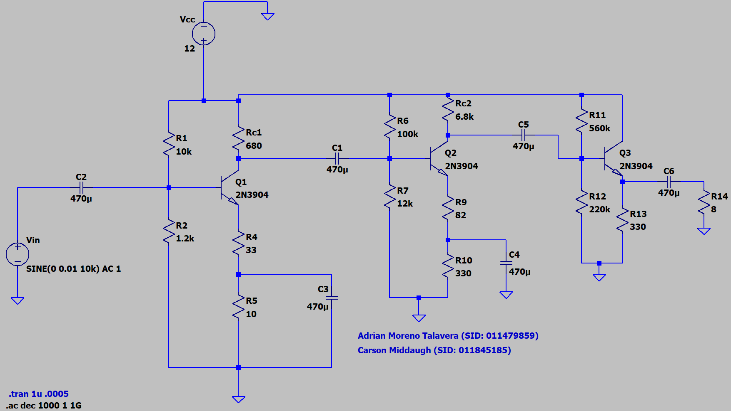
Impedance Bridging
After the Analysis Calculation portion of the design project, there was an effort to impedance bridge between each stage to achieve the desired gain.
This process involved altering resistor values within each stage to change the output impedances, as well as altering the input impedances so that each input impedance was 10x the previous stage’s output impedance.

Slide 8
Analysis Calculations

Slide 9
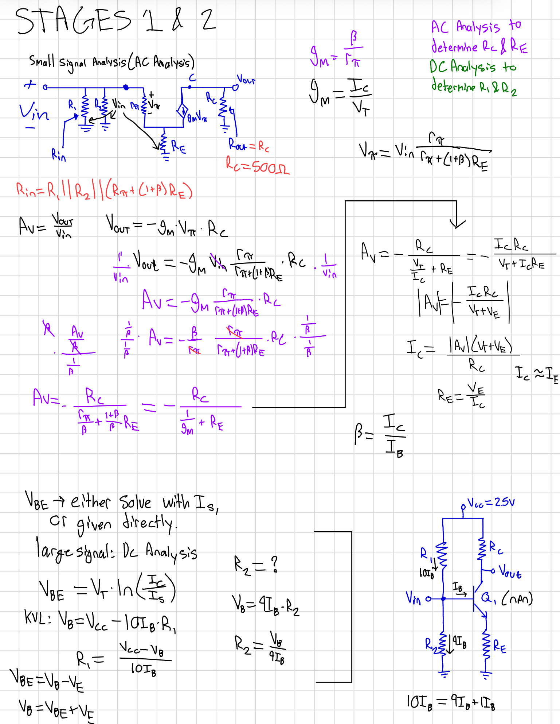
Stage 1 and 2 Analysis
Analysis for Stages 1 and 2 are identical, given they are the same circuit
For the DC Analysis of our circuits, we assumed the current through R1 was equal to 10 times the base current
The only thing that is different between these two stages is the gain

Slide 10
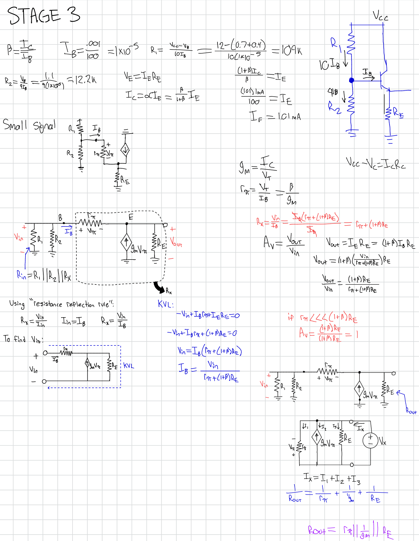
Stage 3 Analysis
Stage 3 is much different from the other two, as it is a common collector BJT
Still, our DC Analysis relied on the assumption that the current flowing through R1 was equal to 10 times the base current

Slide 11
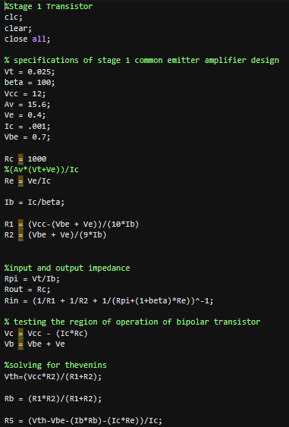
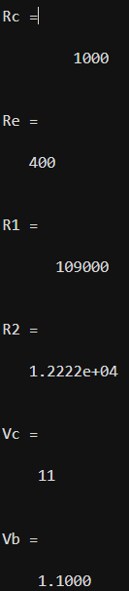
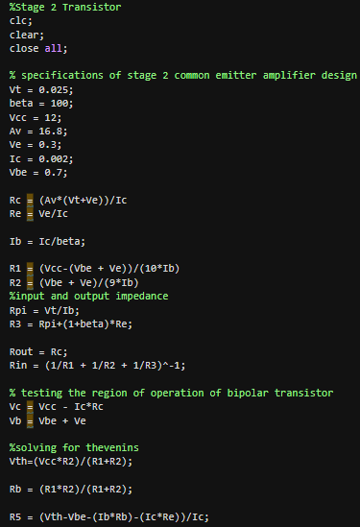
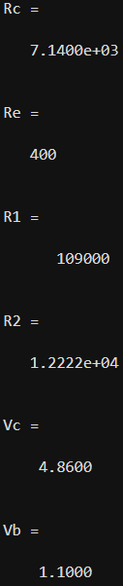
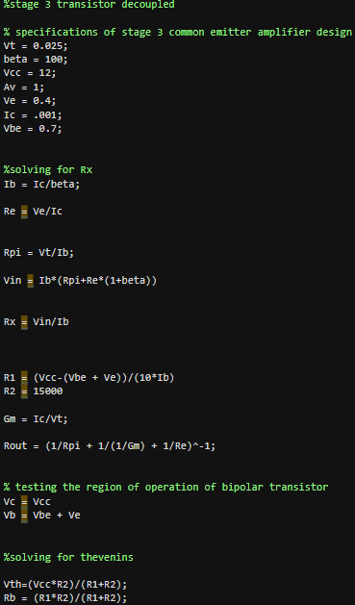
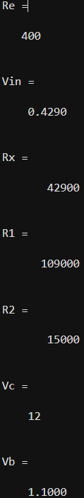
MATLAB
After completing theoretical calculations, we used MATLAB to find all of the values we used

Slide 12
Simulations

Slide 13
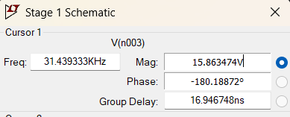
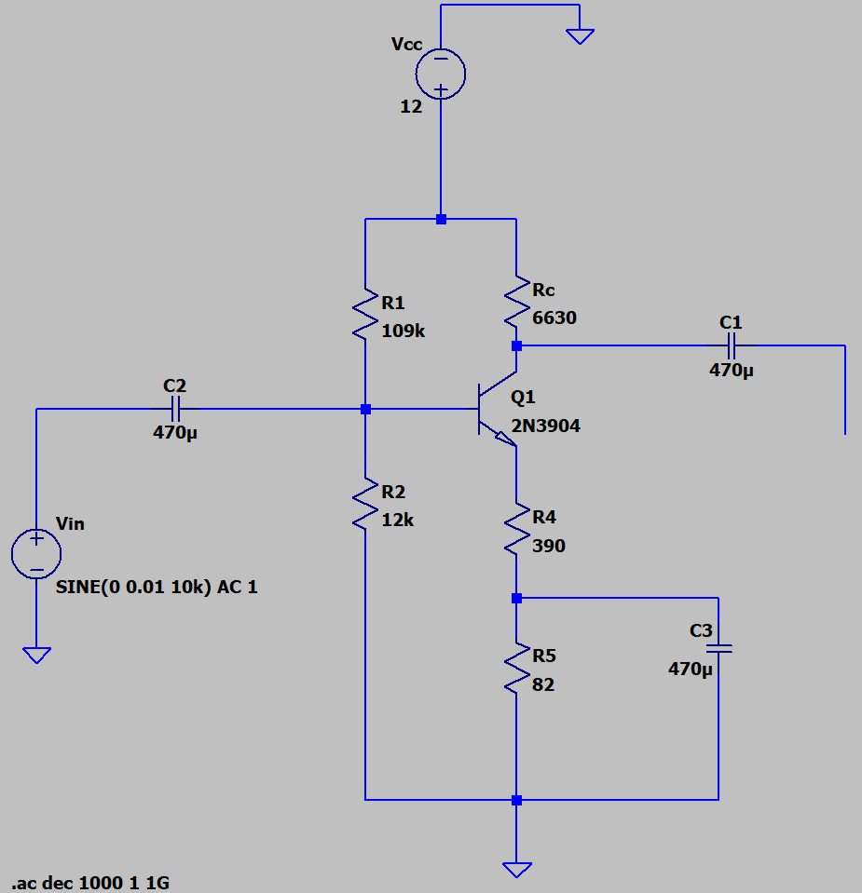
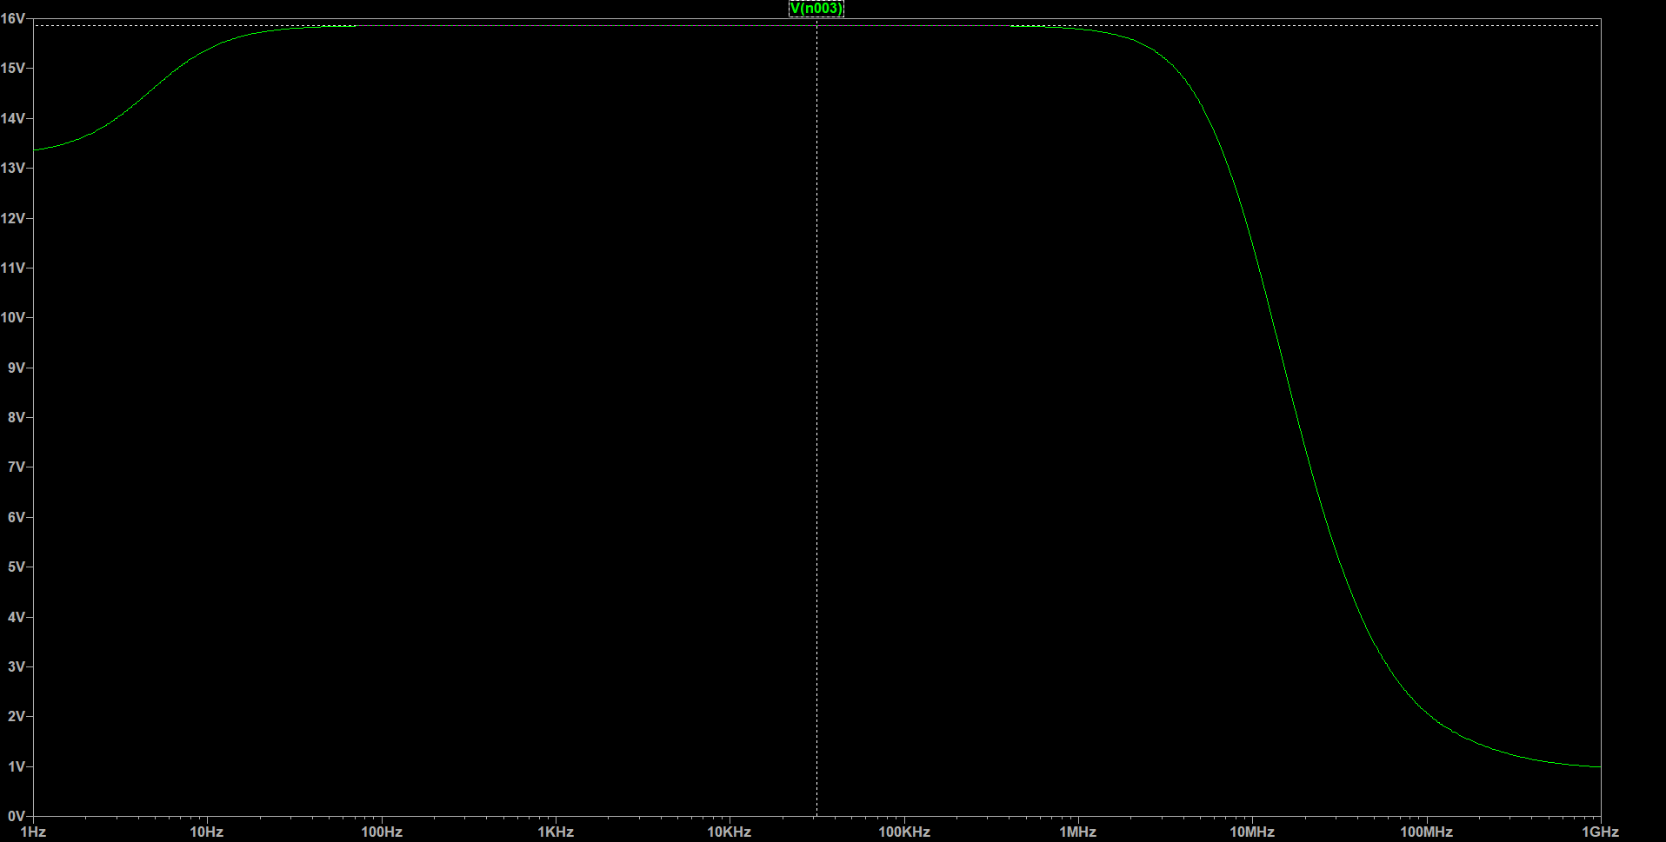
Stage 1 Decoupled

Slide 14
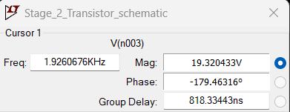
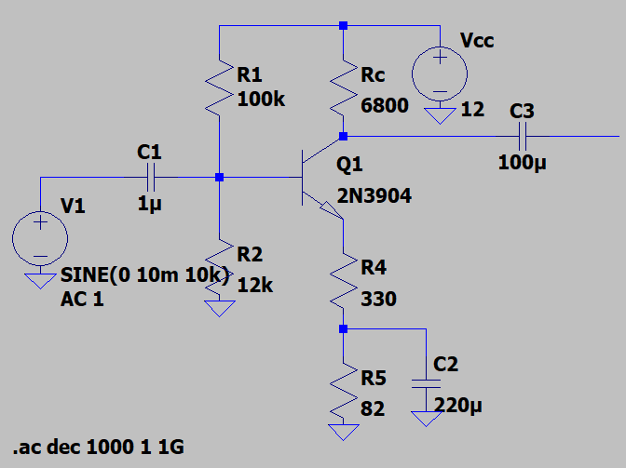
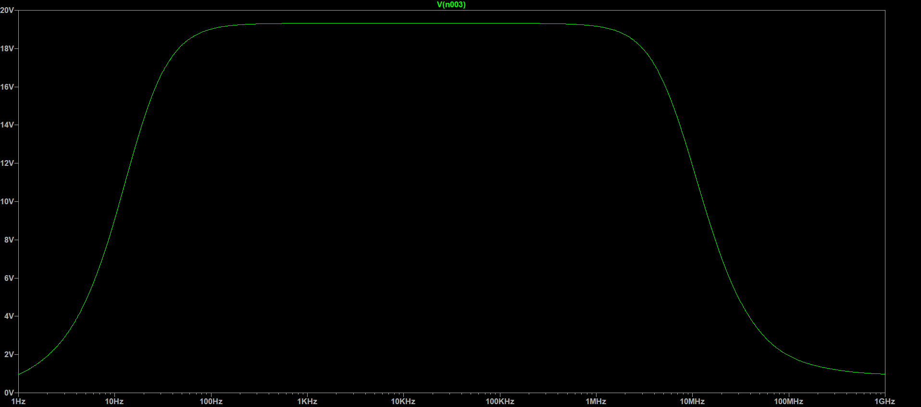
Stage 2 Decoupled

Slide 15
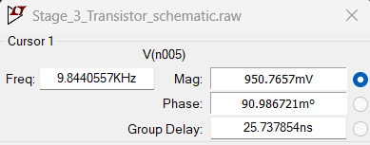
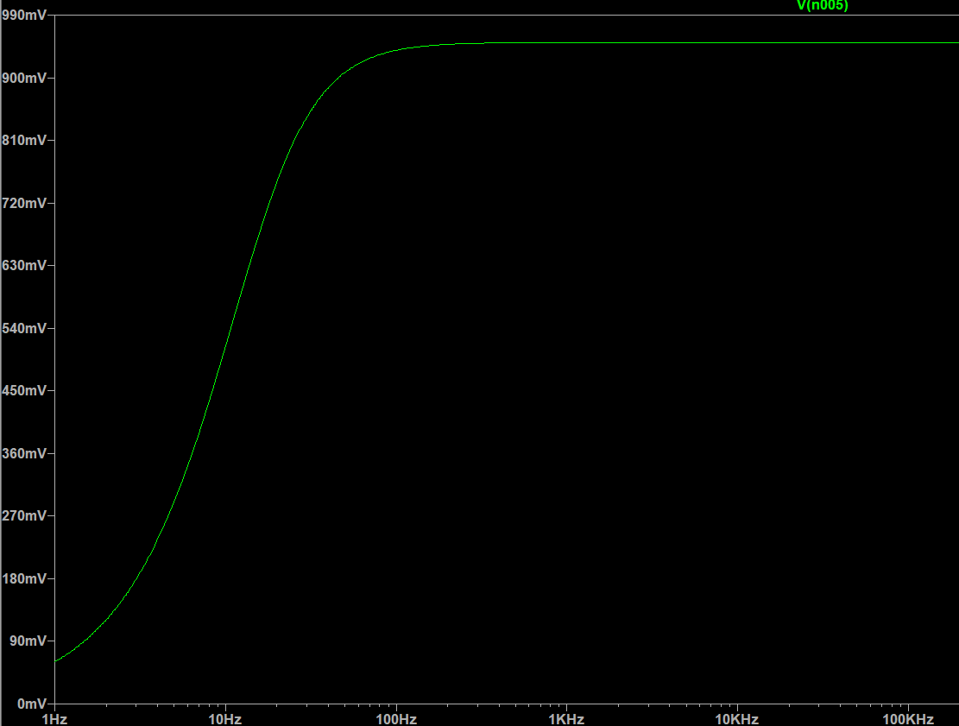
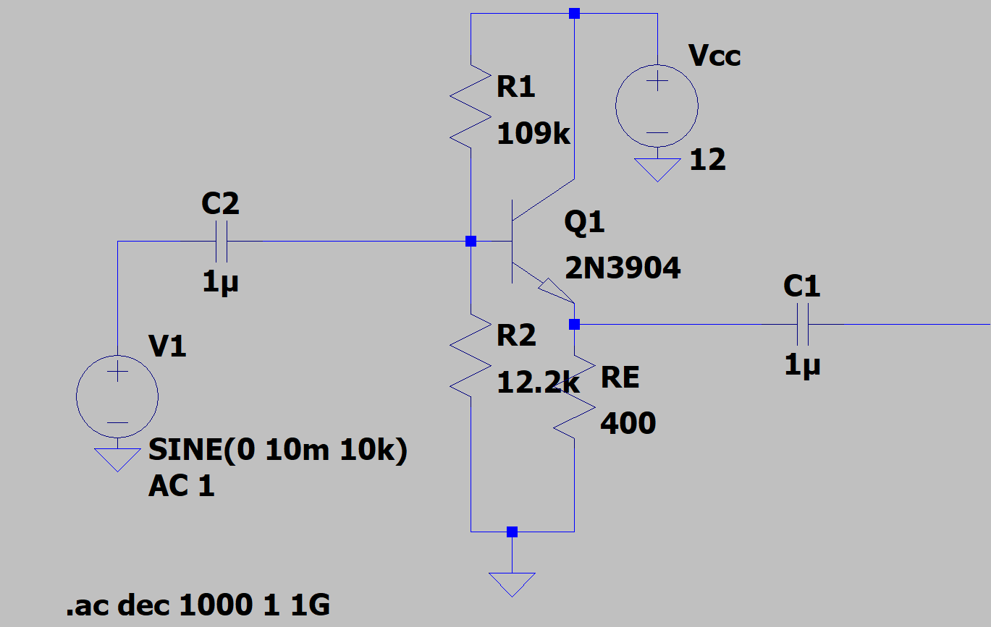
Stage 3 Decoupled

Slide 16
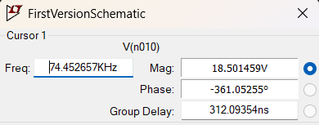
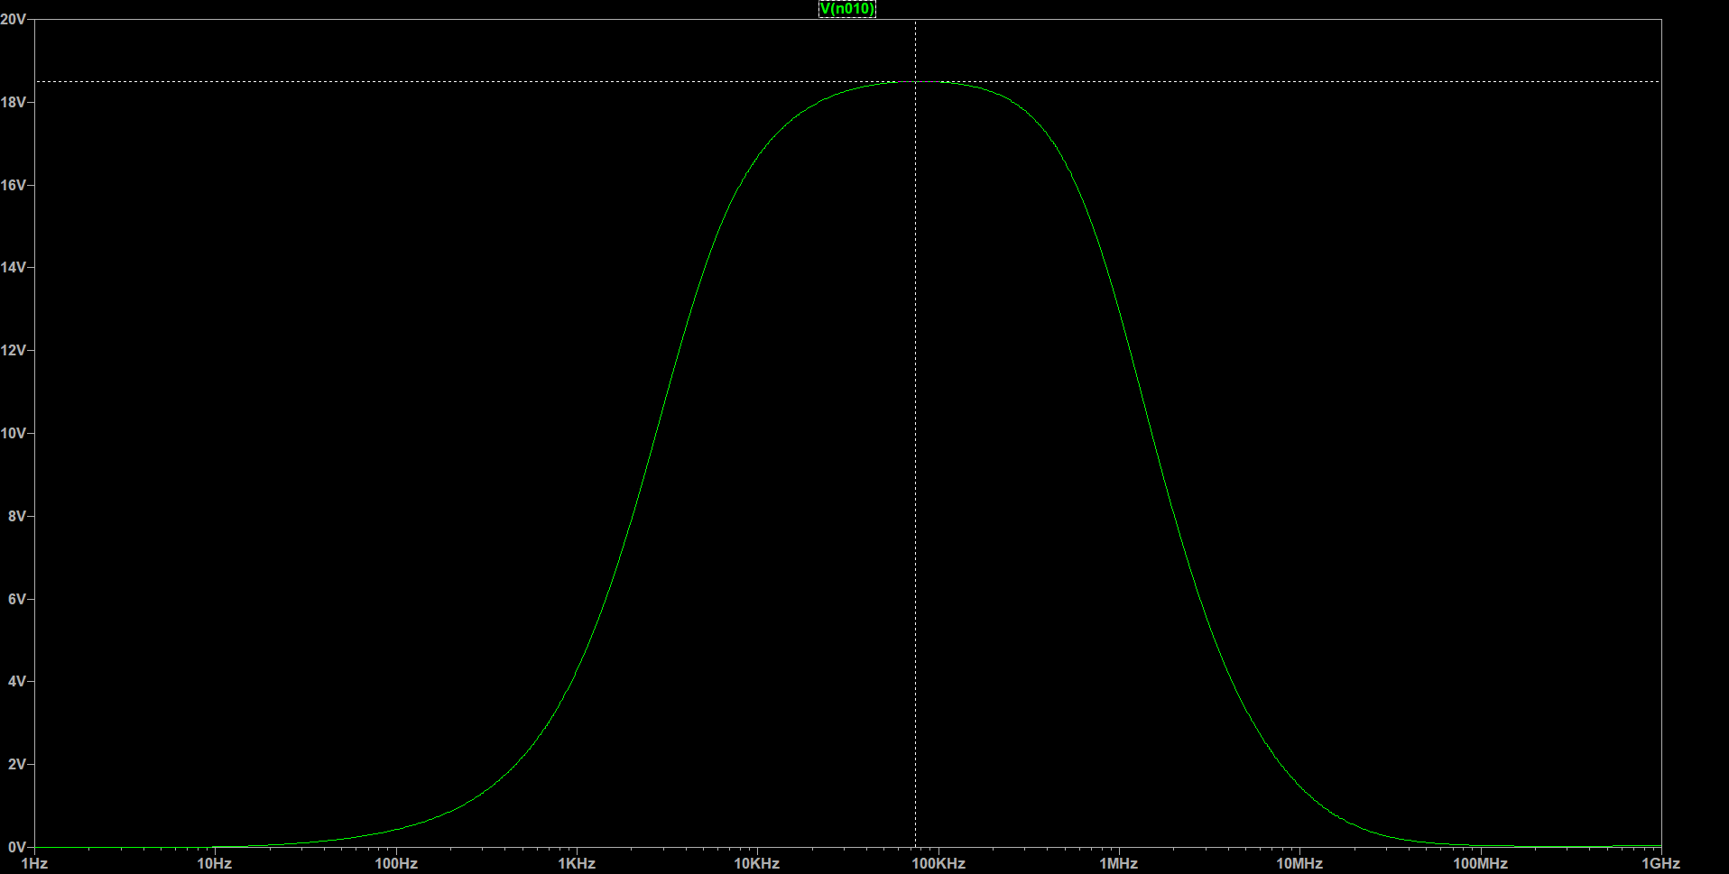
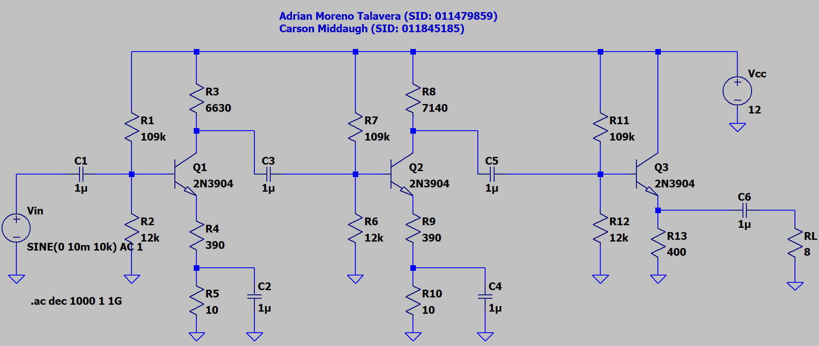
Fully Cascaded Amplifier (Before Impedance Bridging)

Slide 17
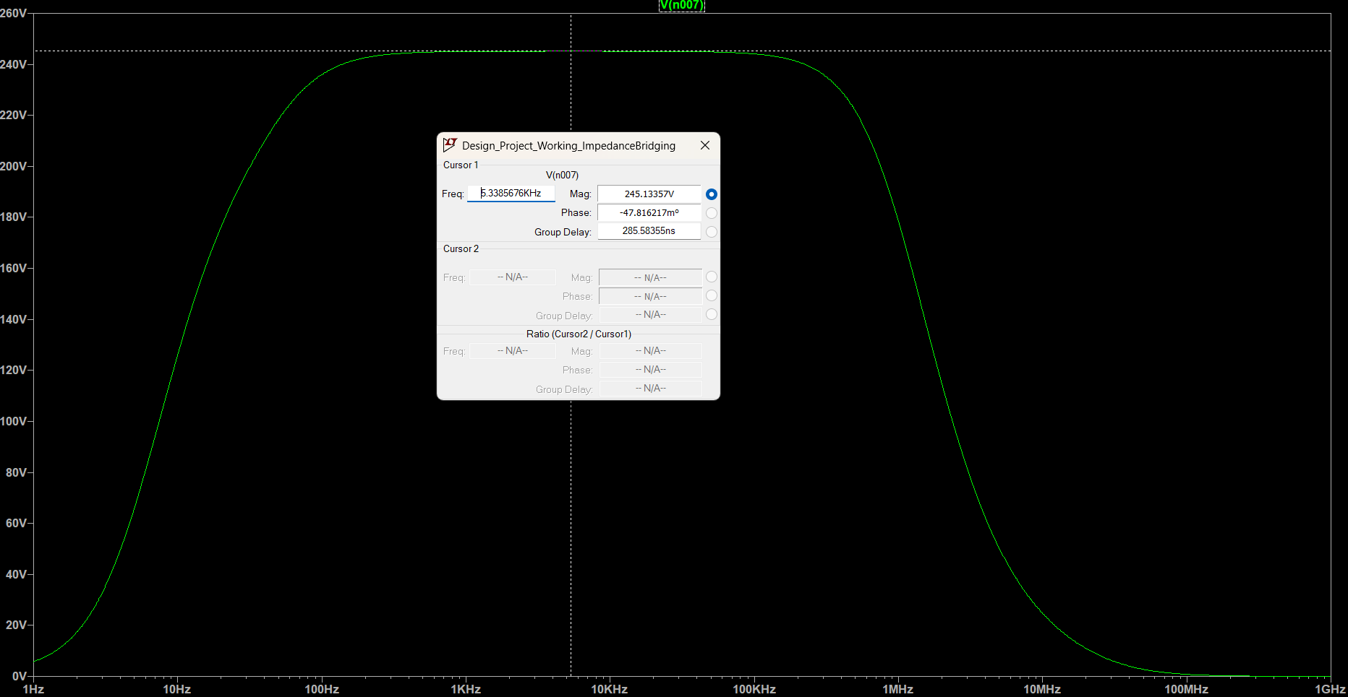
Fully Cascaded Amplifier (After Impedance Bridging)
After adjusting resistor values across the entire circuit, keeping in mind our intended input and output impedances, we were able to achieve a gain of 245, which is close to our calculated value of 262.

Slide 18
Experiments and Implemented Circuits

Slide 19
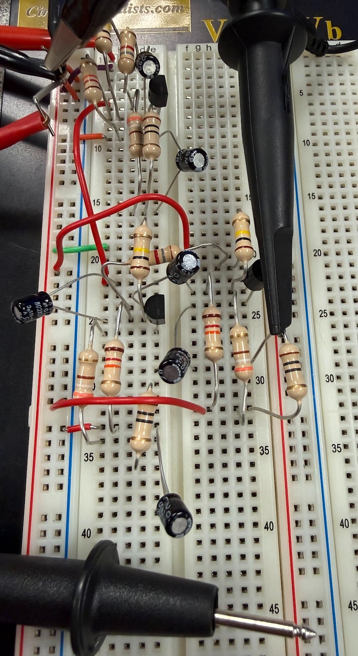
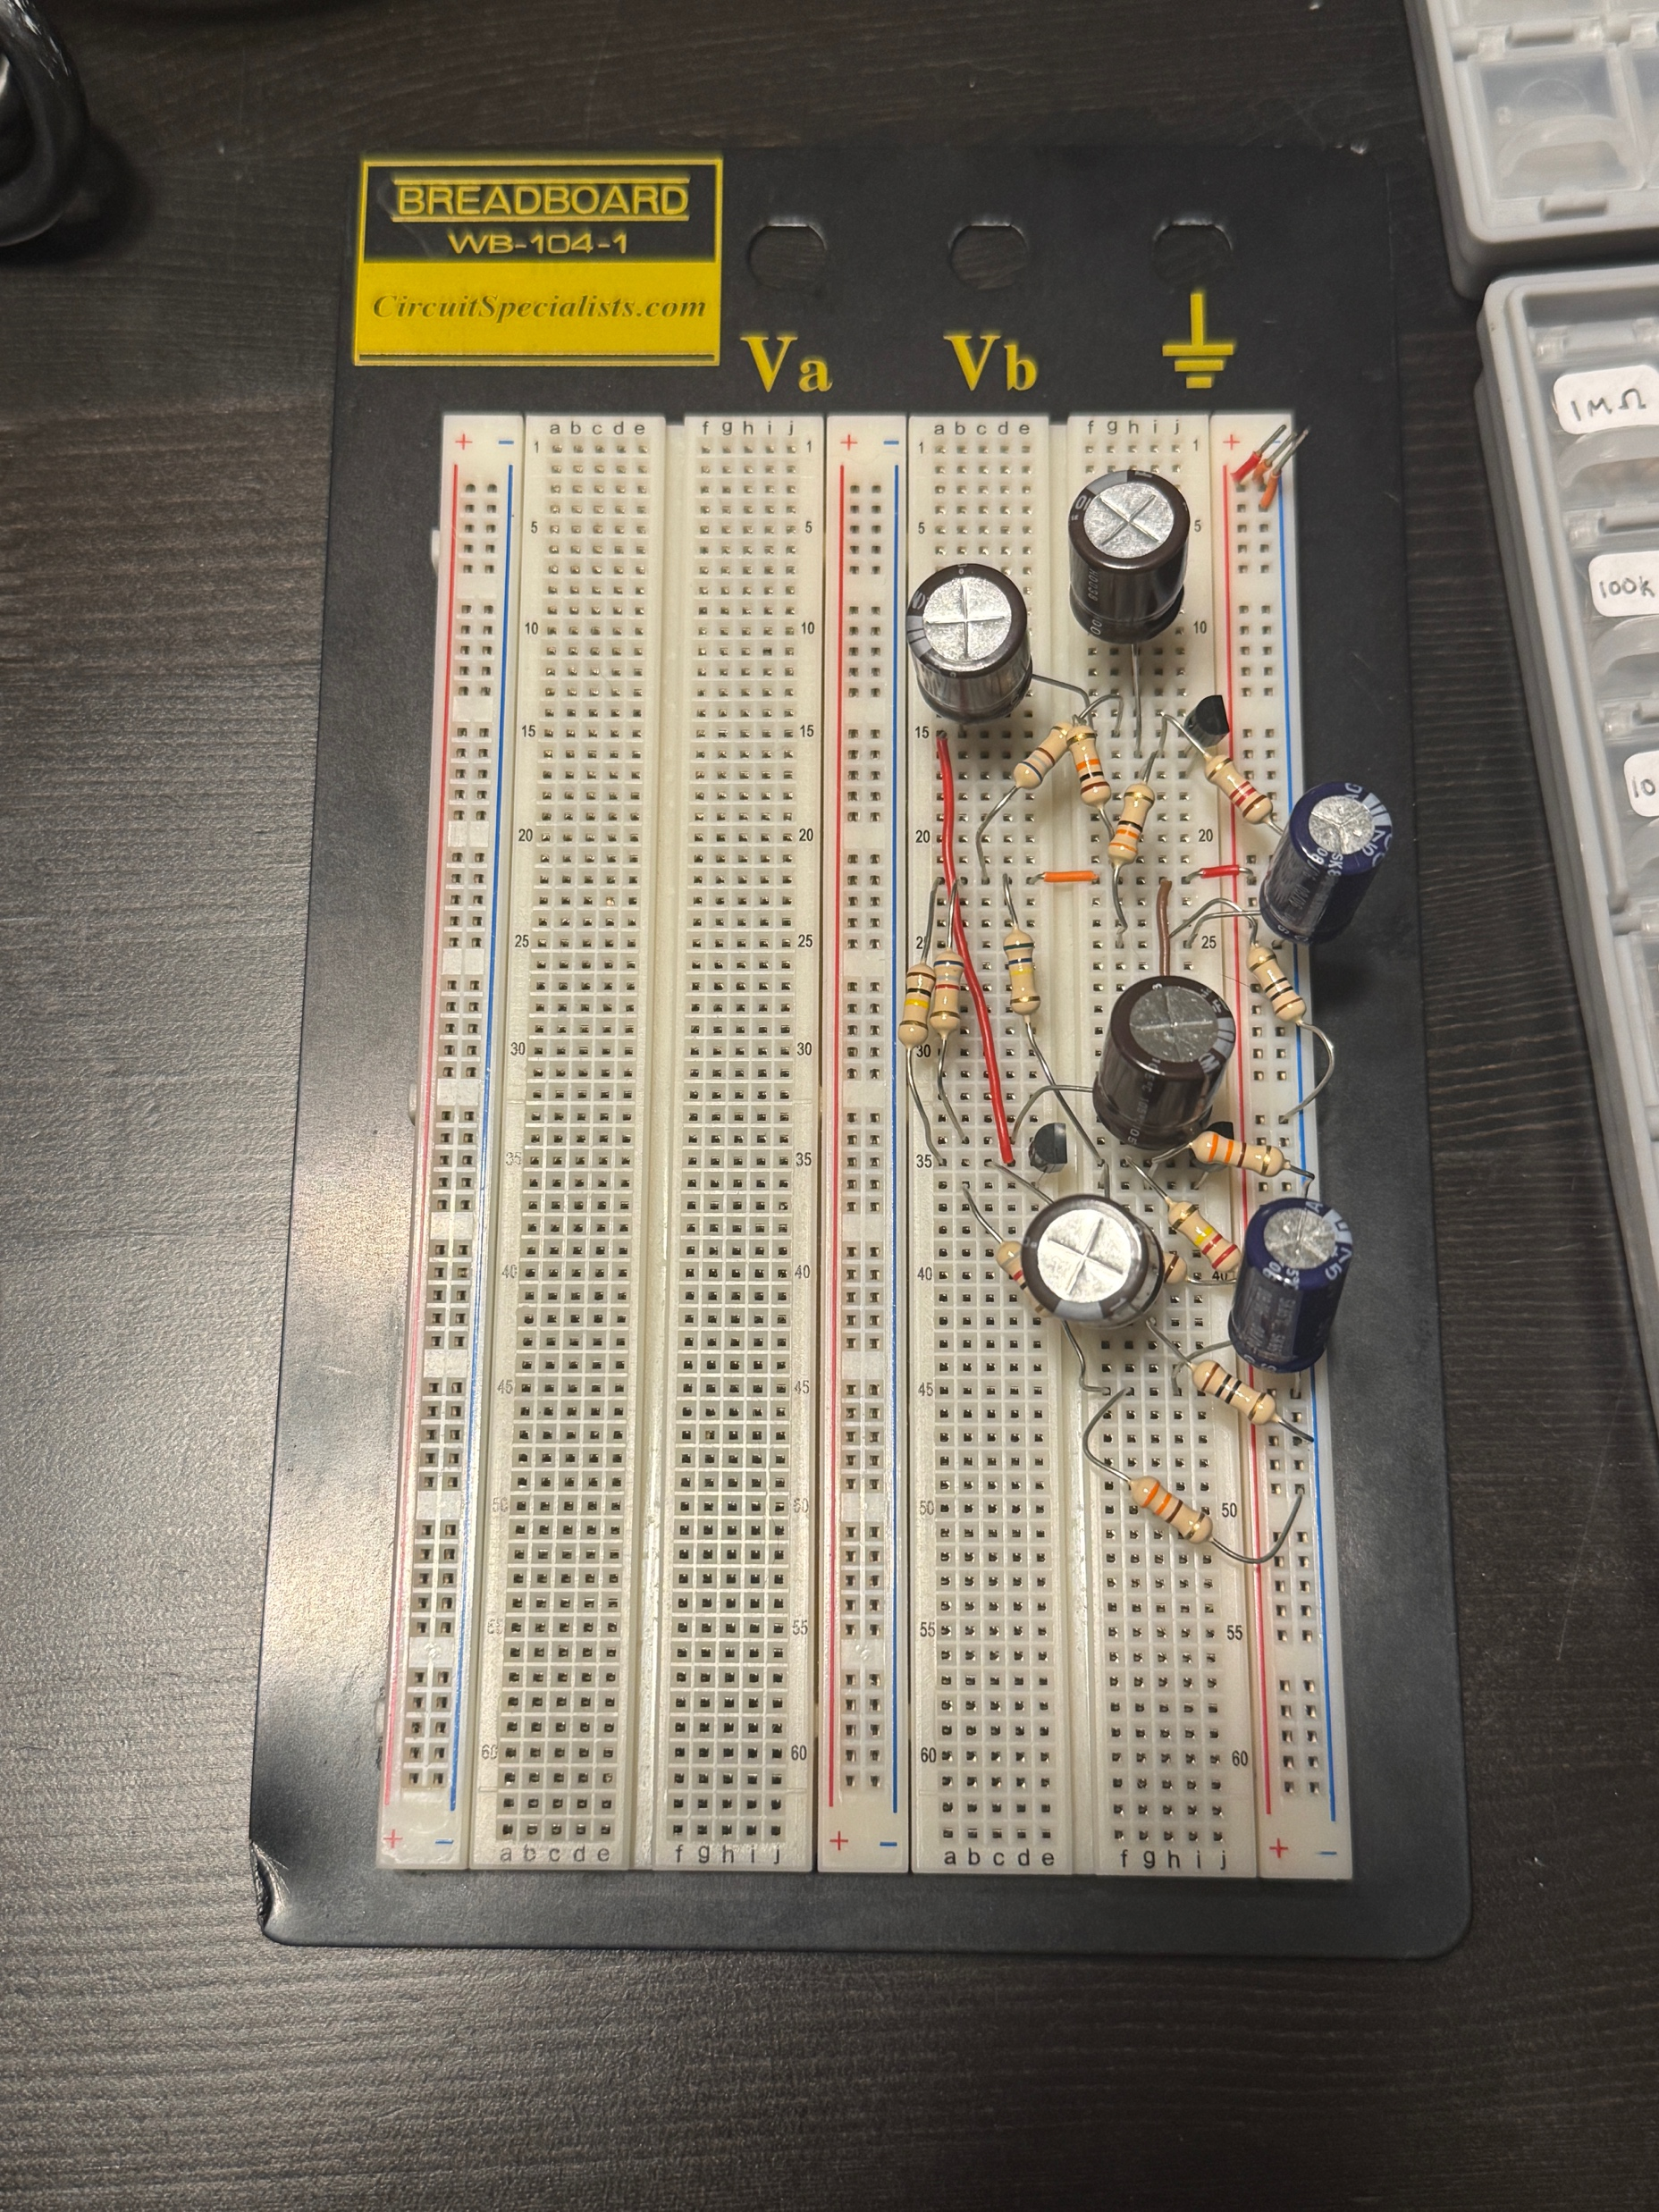
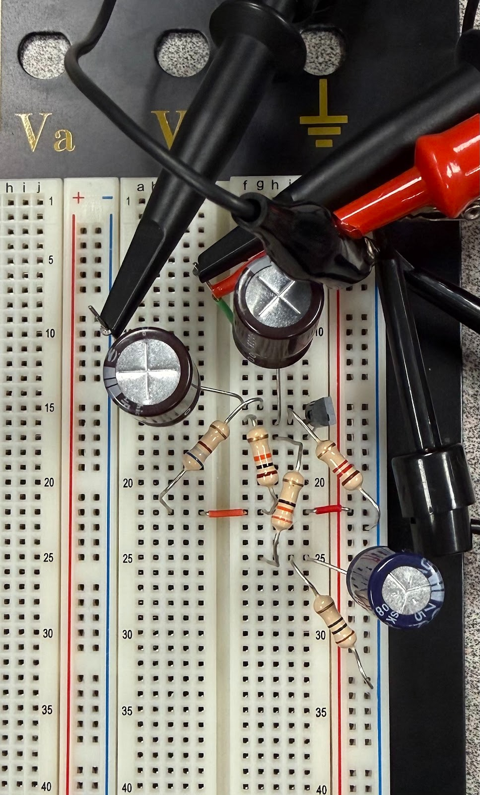
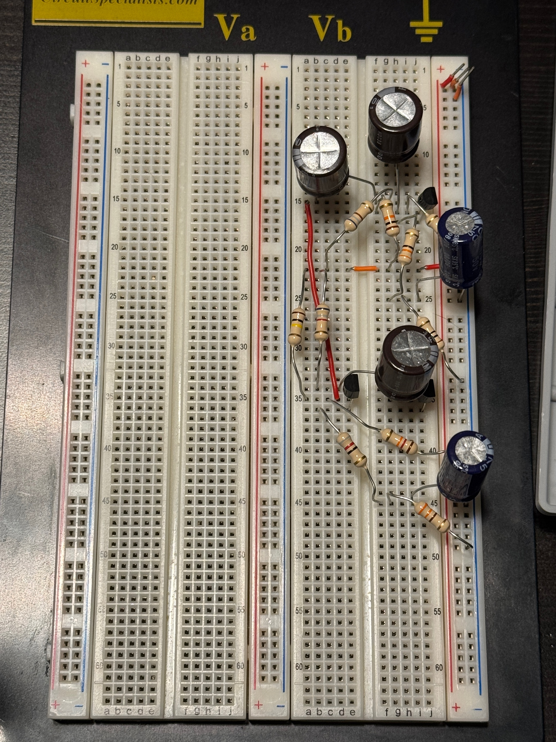
Stages of Experimental Process
Fully Cascaded Amplifier (No Impedance Bridging)
Stage 1 (Decoupled)
Stages 1 and 2 Cascaded
Fully Cascaded Amplifier (With Impedance Bridging)

Slide 20
Conclusion

Slide 21
Iterative Process
As we made our way through this design project, we learned that a significant portion of the work done involved changing variables over and over to achieve the desired results
In exchange for achieving our desired final gain, we had to sacrifice the accuracy of each stage’s gain when decoupled
We achieved a final gain of 245, but stage 1, 2, and 3 don’t match up as closely to their expected decoupled gains of 15.6, 16.8, and 1, respectively

